Slide 1







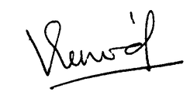


CERTIFICATE
of appreciation
This certificate is proudly awarded to
<<NAME>>
In recognition of your dedication and valuable contribution as a volunteer for IEEE SB IGNITE and the Tech-Talk on ‘Artificial Intelligence in Space Management,’ organized by the IEEE Student Branch, ATME College of Engineering, Mysuru, on 26th March 2025. Your efforts in coordinating and supporting the event played a vital role in ensuring its smooth execution and success, fostering an engaging platform for knowledge sharing and professional growth.
Dr. Vinod Kumar P
Dr. Bhagyashree S R
IEEE ATME SB COUNSELLOR
ATMECE MYSURU
DEAN RESEARCH
ATMECE MYSURU

